Slide 1


3Cs OF SCREEN EDUCATION
CRITICAL ACTIVITIES
SCREEN SESSIONS
WHAT WOULD YOU SAY CRITICAL LEARNING IS?
Pop your thoughts in the chat while you wait.
22 NOVEMBER 2022

Slide 2

Today’s Schedule
4.30pm Arrival and Starter Question
4.35pm Gail Robertson: Welcome and Session Outcomes
4.40pm Louise Sedgewick: Critical Screen Activities
4.55pm Time to Chat
5.10pm Thoughts and Questions
5.20pm Evaluation Time
5.30pm End

Slide 3
Screen Scotland: Our Aim
SCREEN EDUCATION FOR ALL:
The enrichment of the human experience and recognition of the purpose and value of screen as an art form.
FOR LEARNING:
Enriching and expanding the experience of education; developing specific and transferrable skills.
FOR LIFE:
A 21st century approach to making sense of the world and our place in it.
FOR WORK:
Education and training seamlessly link to develop capacities for work related to the screen industries.

Slide 4

Session Overview
What do we mean by “Critical Activities”?
Overview of key techniques
Practical application of film language into lessons using Screening Shorts – “Father and Daughter”
Using critical activities to explore character, theme, setting and so on.

Slide 5
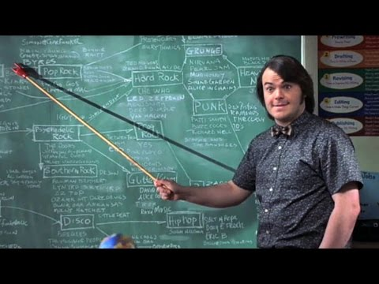
Louise Sedgewick
Louise Sedgewick is an English & Media Teacher at St Margaret’s Academy in Livingston, where she has taught for 16 years. She is also an Into Film Education Ambassador and collaborator with Screen Scotland on different aspects of screen education, such as creating Screening Shorts resources for use in the classroom.
Image credit: Still from School of Rock, Richard Linklater

Slide 6
Screen Literacy
Screening Literacy (the 2011 European Commission on Film Education) defined screen literacy as:
“The level of understanding of a film, the ability to be conscious and curious in the choice of films; the competence to critically watch a film and to analyse its content, cinematography and technical aspects; and the ability to manipulate its language and technical resources in creating moving image production”.

Slide 7
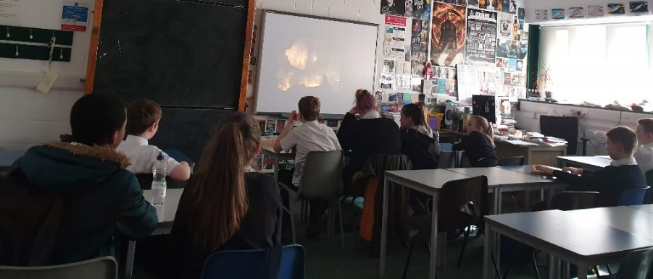
What do we mean by Critical Activities?
Critical analysis of a film includes:
  Identifying film techniques
  Analysing how those have been used
  Evaluating their impact on the audience
And it also means:
  Considering audience and purpose
  Considering different interpretations of the film
  Making links between different parts of the same film and with other films
  Questioning why different choices have been made
This can be summed up as WHAT?, HOW? & WHY?

Slide 8

Screening Shorts
If you don’t know where to begin with teaching film it can feel quite daunting. However, there are a lot of resources out there to help you as you start out.
Screen Scotland’s Screening Shorts has a Tile on Glow and every teacher in Scotland has access to this whole bank of film content and teaching resources.
  https://screeningshorts.org.uk/resources/classroom-resources
Here you also have access to a library of over 100 short films suitable for a huge variety of curricular areas and levels.

Slide 9

Overview of Key Techniques
The four key areas for screen language can be broken down into:
  Camera – shot size/framing; angle; movement
  Sound – music; sound effects; dialogue
  Mise-en-scene – “everything in the shot”
  Editing – how the film moves between shots/scenes
For the purposes of today’s short session, I will focus mostly on camera with a brief overview of the other techniques.
I have signposted resources which can help you further with your classroom practice.

Slide 10
Camera
Camera framing – shot size
  This means how far away the camera is from the subject.
  Shot size is chosen to help tell the story and convey different ideas to the audience.
  There are variations on how these are described so don’t worry about getting it wrong. You only need the basics for most lessons.

Slide 11
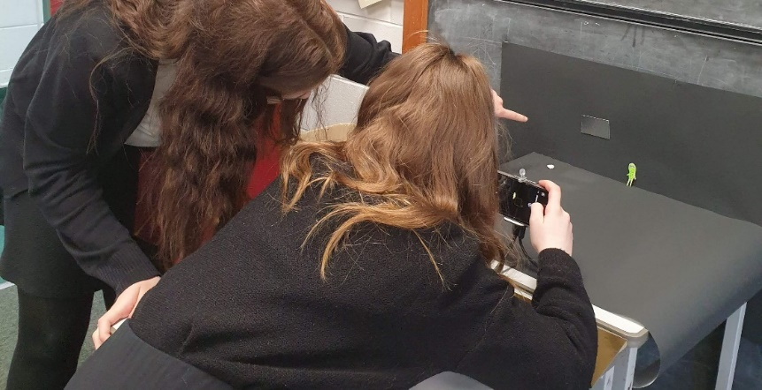
Camera – Shot Size
EXTREME LONG SHOT (ELS)
Emphasise location or isolation; can be used as an ESTABLISHING SHOT at head of scene to establish location
LONGSHOT (LS)
Highlights background or onlookers while keeping subject in plain sight
FULLSHOT (FS)
Highlights costume or shows multiple characters at once
MEDIUMSHOT (MS)
Good for dialogue in scenes
CLOSE-UP (CU)
Reveals emotions and reactions; intensity
EXTREME CLOSE-UP (ECU)
Emphasis on smaller details; pulls attention to importance; intensity

Slide 12



Camera – Shot Size
I teach a unit of work to S2 on the film Wall-E
We look at what the different shot sizes here tell us about the character of Wall-E, the story, the setting…
Image credits: Wall-E, Andrew Stanton

Slide 13
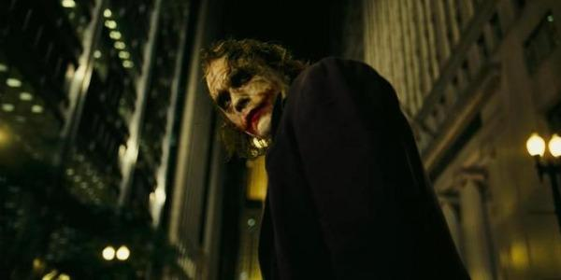
Camera – Angles
This means where the camera is in relation to the subject. The main angles are:
EYE LEVEL
Mimics how we see people in real life - conversational
LOW ANGLE SHOT
Makes subject appear larger and more dominant
HIGH ANGLE SHOT
Makes subject appear smaller and weaker
WORM’S EYE SHOT
Highlights what is happening on the ground
BIRD’S-EYE SHOT
Creates a sense of scale and movement, or acts as God’s eye looking down from Heaven
DUTCH ANGLE SHOT (Tilt)
Creates disorientation
AERIAL SHOT
Establishes a large expanse of scenery
Image credit: The Dark Knight, Christopher Nolan

Slide 14
Camera – Movement
How the camera moves adds to the storytelling. Basic movements can be described as:
STATIC SHOT – still camera
Good for comedy as it emphasises performer’s movement
DOLLY SHOT - camera moves smoothly, mounted on a track (dolly)
Creates a sense of movement/pace
ZOOM LENS SHOT - camera stays in one place, using zoom to “move” closer; less of the setting is seen
Can show a character’s shock or surprise
PAN SHOT - the camera base is in a fixed position but the camera moves around the scene
Can reveal something or allow the following of an action
TILT SHOT - as a pan shot, only vertical instead of horizontal
Can reveal something or allow the following of an action
TRACKING SHOT – the camera moves along behind or beside the subject
Makes audience feel as if they are following character

Slide 15
Sound
Film sound is used for many different purposes, including to:
establish time, place, character, genre, tone, mood…
immerse the audience in the film’s “reality”
aid narrative continuity
provoke an emotional response from the viewer
elevate the film beyond the visual or narrative alone, connecting with the viewer on a sensory level

Slide 16
Sound
There are three areas of sound:
Dialogue and recorded sound: diegetic sound which accompanies the action on screen.
Sound effects: both on and offscreen; tend to be diegetic, though they may be artificially created in a Foley studio or exaggerated in post-production.
Music: can be diegetic (e.g. from a car radio) but is more often non-diegetic.
Diegetic sound: sound motivated by the action in film (i.e. sound the characters can hear).
Non-diegetic sound: sound not directly connected to the action on screen (i.e. sound the characters cannot hear, typically music which is added on).

Slide 17
Sound
As sound can be very tricky in online sessions, the following resources can help you with teaching sound in your lessons:
https://www.youtube.com/watch?v=iSkJFs7myn0 – Shows the importance of music and how it affects the mood, atmosphere and even genre of the piece
https://www.youtube.com/watch?v=UO3N_PRIgX0 – The Magic of Foley (sound effects) shows how Foley artists create the sound effects in film. This can be a great fun practical activity too!

Slide 18
Mise-en-scène
From the French meaning, literally, “put in the scene”.
This therefore involves everything you see in the frame:
  colour
  costume (clothing, hair, make-up, accessories, defining marks…)
  set (location, style, furniture, props…)
  lighting
  actor position
Mise-en-scène is all about understanding that everything in the frame was deliberately placed there for a specific reason.

Slide 19
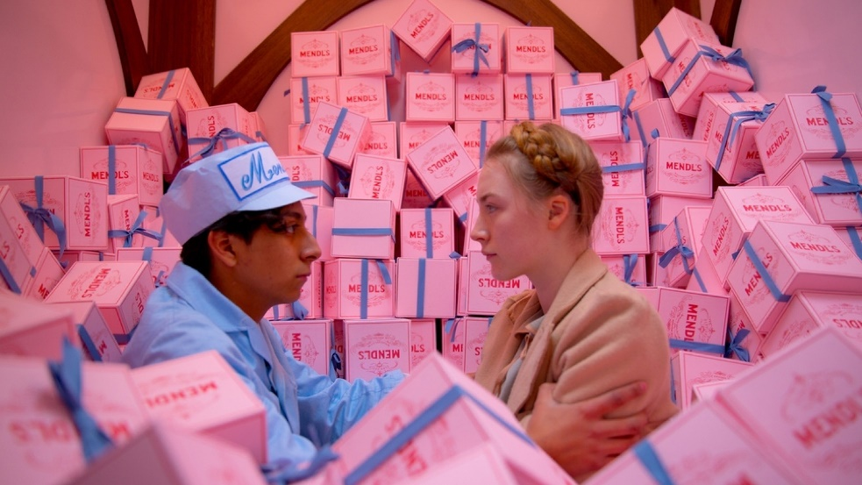
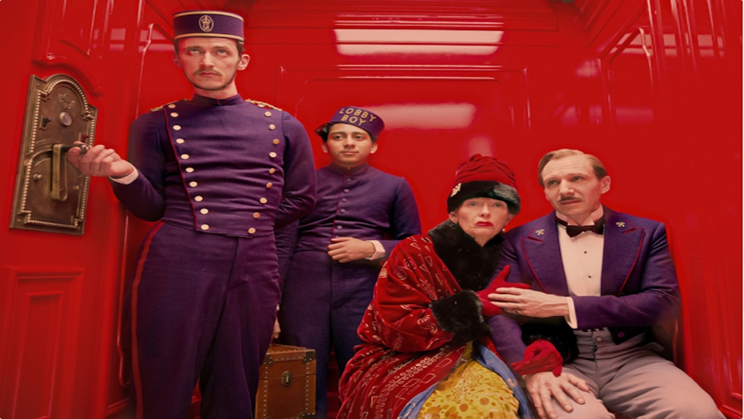
Mise-en-scène
  colour
  costume (clothing, hair, make-up, accessories, defining marks…)
  set (location, style, furniture, props…)
  lighting
  actor position
Image credits: The Grand Budapest Hotel, Wes Anderson

Slide 20
Editing
Editing is the process of taking individual shots and combining them to form sequences that, when joined together, tell a screen story that flows and makes sense. The logic of the shots and the flow of the narrative need to have been planned when writing and storyboarding the film.
Cuts and transitions in films are like written punctuation–they act like full stops, paragraph breaks and chapter breaks, and give structure to the screen narrative.
There are different types of cut, which all help to create impact on the audience and add to the storytelling.
Screen Scotland’s resource on camera, sound, mise-en-scène and editing can be found here: https://screeningshorts.org.uk/resources/classroom-resources

Slide 21
Critical Activities: Mise-en-scène
Annotate a still from a film/TV show with what can be learned about a character’s life from the mise-en-scène (set, props, colour etc.)
Research colour psychology and design a costume/set/film poster/advert using colour deliberately.​
Look at the “costume” you are currently wearing (or a favourite outfit) and outline what it tells people about you.​
Have a box of typical classroom equipment and dress a desk in two halves: one for a studious pupil, and one for a pupil who hates being in school.​
Using a box, design and make a model bedroom set for a film/TV character of your choice. Use labels to explain your choices of décor!​
Gather different types of lights (torches, lamps, battery-operated candles, coloured plastic film…). Make bounce boards with cardboard and tinfoil. Practice different lighting setups.​
Mime different body language and positioning to convey different emotions/ situations (discomfort, sulking, going into an exam…)​

Slide 22
Critical Activities: Sound
This video from the sound team of ‘The Lord of the Rings’ films gives a fun overview of their work: The Soundscapes of Middle-Earth | The Lord of the Rings ​
Gather a selection of objects that can create sound and let the class explore them. Think creatively - a blown up hot water bottle squeaked along a table sounds like a car screeching round a corner! ​
Play a short film without sound and get the class to provide the sound effects.​
Choose a character from a film or TV show then create their ideal playlist. Give reasons for choices.​
Choose a moment from a film or TV show that has great emotional impact. Choose an appropriate song for that moment and play it over the scene.​
Film a location then add appropriate ambient sound from an effect library like Free Sounds Library . Then add different effects (e.g. a scream) to see how it changes the mood.​

Slide 23
Critical Activities: Camerawork
Freeze-frame and focus on particular shots. By examining such things as the angle, distance and movement of the camera (along with the use of mise-en-scène), you learn how every element of a visual image can carry meaning, and how visual images can be ‘read’ like any other text. Camera and Editing: Freeze Frame | Screening Shorts​
Choose an exciting extract (opening scenes are good) from a novel or short story and storyboard it, thinking about how to establish character and setting. Then film it!​
Make a six-shot silent film using at least four different camera shots. Titles for easy ideas are ‘The Chase’, ‘The Discovery’ and ‘The Scare’.​
For an easy ‘no-edit’ approach to making a film, film each shot in sequence and just let each clip play naturally.​

Slide 24
Critical Activities: Editing
Using the pause button, 'transcribe' a short sequence from a film (6-20 shots) by copying each shot off the screen onto a storyboard template. Annotate this with notes on sound and action. Think about how the shots work together and apart to create an effective sequence. Questions can be found here: Camera and Editing: Shots in Sequence | Screening Shorts​
Download a film from Screening Shorts and edit a 20-30 second trailer for it.​
Download some footage – or simply some still images – from a film that sits firmly in a certain genre (e.g. romance). Then edit the footage and add captions, sound effects, music, etc. that change the genre.

Slide 25
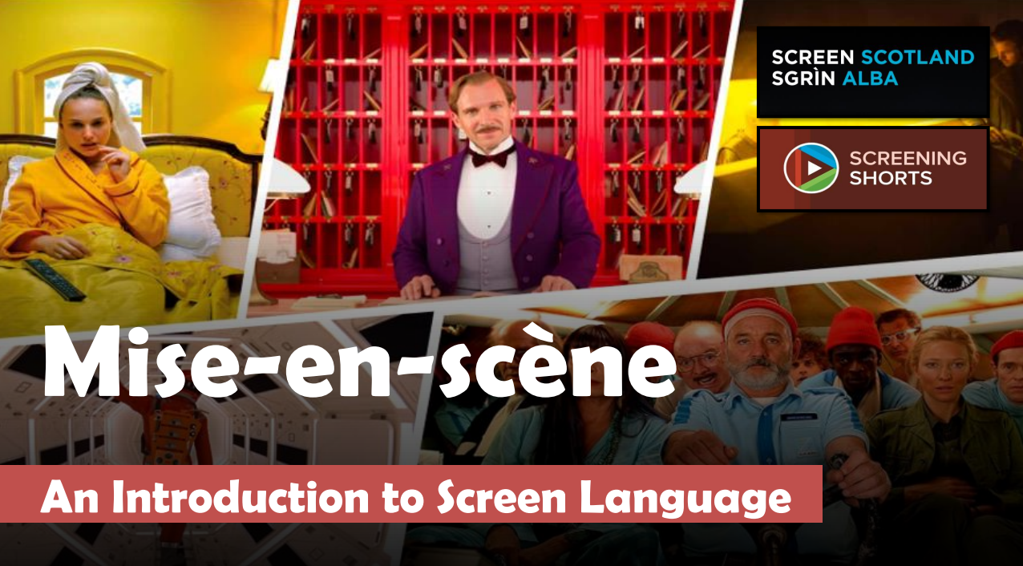
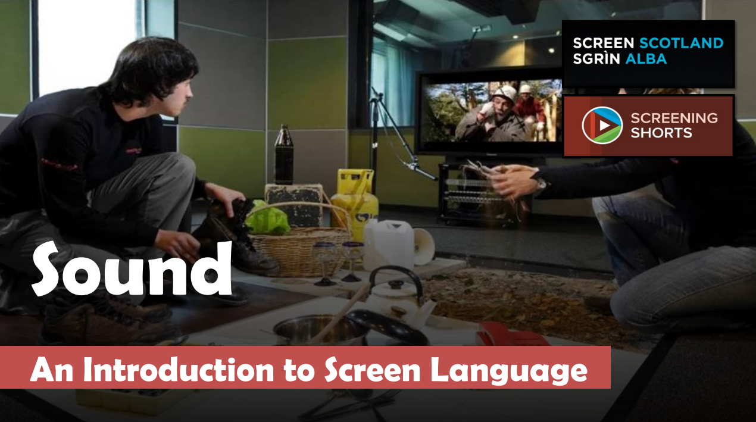
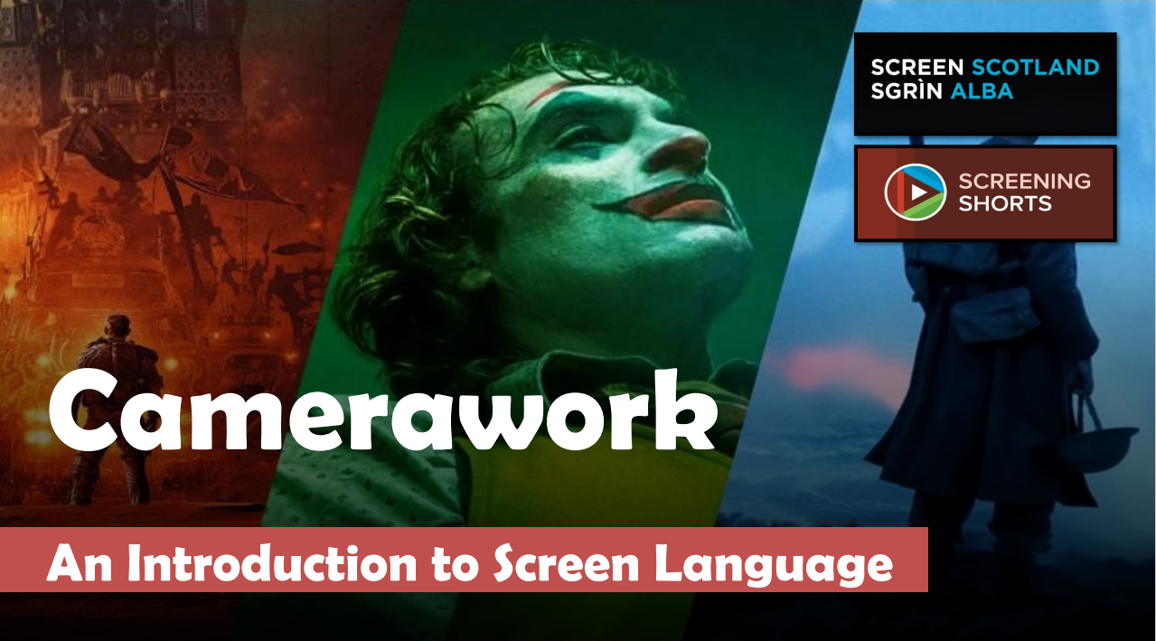
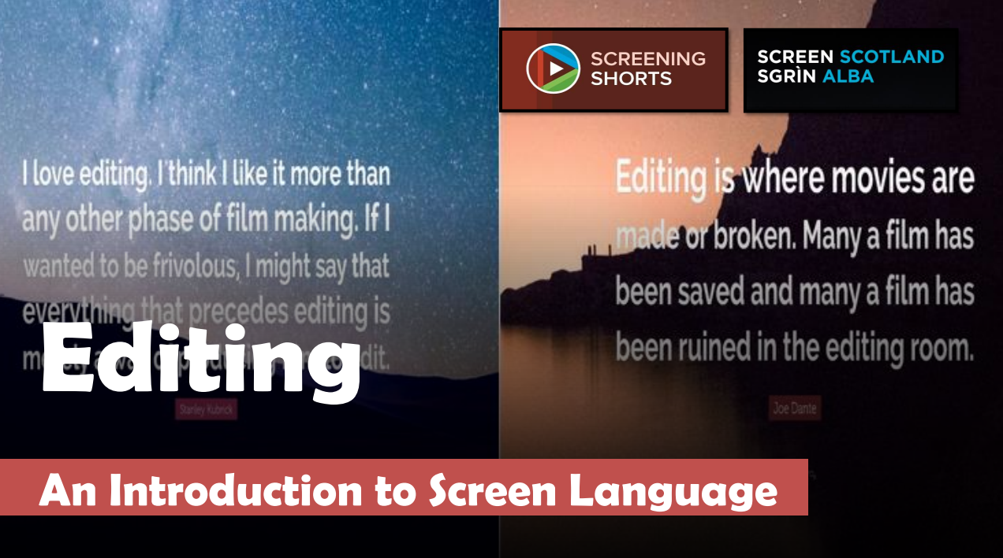
Learning the Language of Screen

Slide 26

Time to Chat
DISCUSS
In what ways do the critical screen activities you’ve learned about connect with other areas of learning?
Which areas of critical learning with screen do you think might be challenging?
How could these challenges be overcome?

Slide 27

Thoughts and Questions

Slide 28

Evaluation Time
The Screen Education Team want our Screen Sessions – and everything we do – to be led by those on the ground, so your feedback is really important to us.
Please take this time to think about what you’ve gained from today’s session and what questions you still have.
Pop your comments and questions in the meeting chat or feel free to send us your comments via: Gail.Robertson@creativescotland.com

Slide 29
Coming Up: Screen Sessions
Next month’s Screen Session is:
3Cs OF SCREEN EDUCATION: CULTURAL ACTIVITIES
You will find the booking link, alongside the full 2022/23 schedule and recordings of all our previous sessions here: Teacher CLPL Sessions | Screen Scotland

Slide 30
What next?
Visit our website Screening Shorts, with nearly 100 short films alongside teaching guides, activities and resources.
Join our network for updates on events/opportunities and to chat to other educators: Screen Scotland: Screen Education | Microsoft Teams
Consider applying to our Screen Education Fund: you can ask for up to £35,000 to pilot a screen education project.
Learn more about Screen Scotland’s Education work: Screen Education | Screen Scotland Website
Contact the Screen Education Team directly:
  Fi.Milligan-Rennie@creativescotland.com Head of Education - Screen
  Gail.Robertson@creativescotland.com Screen Education Officer

