Slide 1


3Cs OF SCREEN EDUCATION
CULTURAL ACTIVITIES
SCREEN SESSIONS
WHAT’S YOUR ULTIMATE CHRISTMAS FILM?
Pop your thoughts in the chat while you wait.
13 DECEMBER 2022

Slide 2


Today’s Schedule
4.30pm Arrival and Starter Question
4.35pm Welcome and Session Outcomes
4.40pm Cultural Screen Education
4.55pm Time to Chat
5.10pm Any Questions?
5.20pm Evaluation Time
5.30pm End

Slide 3
Screen Scotland: Our Aim
SCREEN EDUCATION FOR ALL:
The enrichment of the human experience and recognition of the purpose and value of screen as an art form.
FOR LEARNING:
Enriching and expanding the experience of education; developing specific and transferrable skills.
FOR LIFE:
A 21st century approach to making sense of the world and our place in it.
FOR WORK:
Education and training seamlessly link to develop capacities for work related to the screen industries.

Slide 4
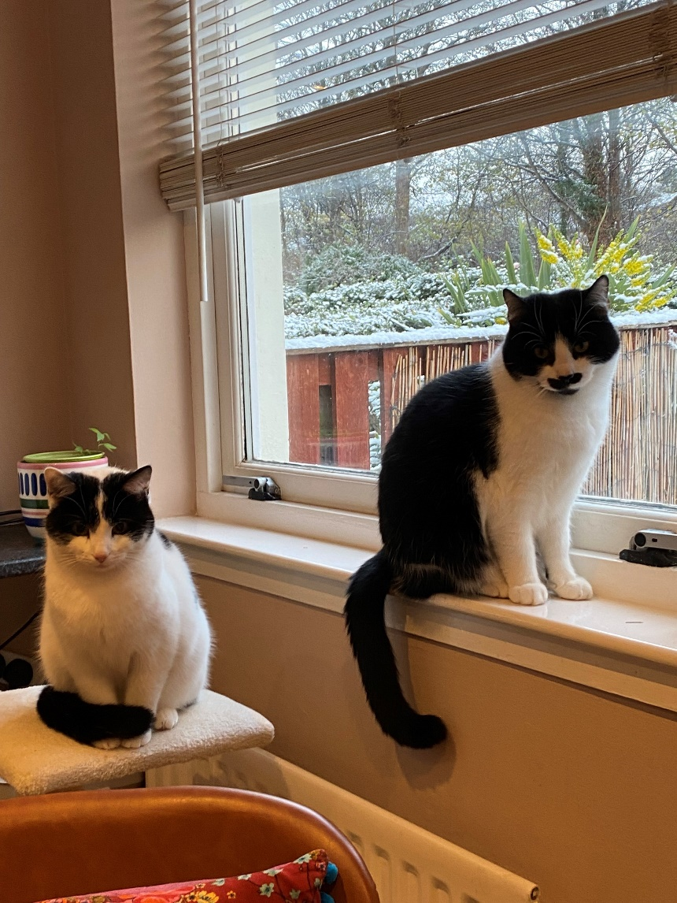
Gail Robertson
Two cats – Flo and Otis, aka Flotis.
BA (Hons) in Film & Media/English from the University of Stirling.
Secondary Media and English teacher for 15 years in Fife, Perth & Kinross, Edinburgh and London.
Screen Education Officer since 2020.
Love all film musicals. Except ‘Mamma Mia’.

Slide 5

Session Outcomes
What is cultural screen education?
What learners need to understand
Suggested activities for Early Years to Senior Phase
Potential concerns about cultural discussions

Slide 6

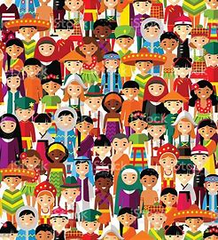

The Three Cs of Screen Literacy
Film Literacy: Critical, Cultural and Creative Approaches | Screening Shorts
Critical
Creative
Cultural

Slide 7
Cultural Screen Education
Screen texts as the creator of social consciousness.
Studying a film to create awareness of other societies and cultures, how groups are represented on screen (and the good or harm this can cause) and how diverse audiences can be.
Incorporates personal knowledge, response and choice.
  Brings existing knowledge to the fore, allowing connections to be made between what they’ve just watched and what they’ve previously watched, read, experienced..., giving value to each person’s contribution.
Challenges and influences how we respond to the world in reflective and imaginative ways, with huge benefits in terms of wellbeing, employability and skills development.

Slide 8
Cultural Screen Education
When we watch a film:
What do we learn about the world?
What do we learn about ourselves?
What do we bring from ourselves?

Slide 9
Understanding that…
Cultural events/movements (historical, political, social…) can be reflected on screen.​
Film/screen texts from different countries all have clear differences related to their culture.​
Representations of people, places and events can be deliberately constructed by a filmmaker, and connect to the filmmaker’s agenda.​
Representations on screen can have a positive and/or negative impact on society.​
What we see/hear can help identify the intended audience for a film/screen text.​
Content and/or screen language can have a different effect on different audiences.​
Personal experiences, beliefs and/or background have a direct impact on our experience as an audience member.

Slide 10
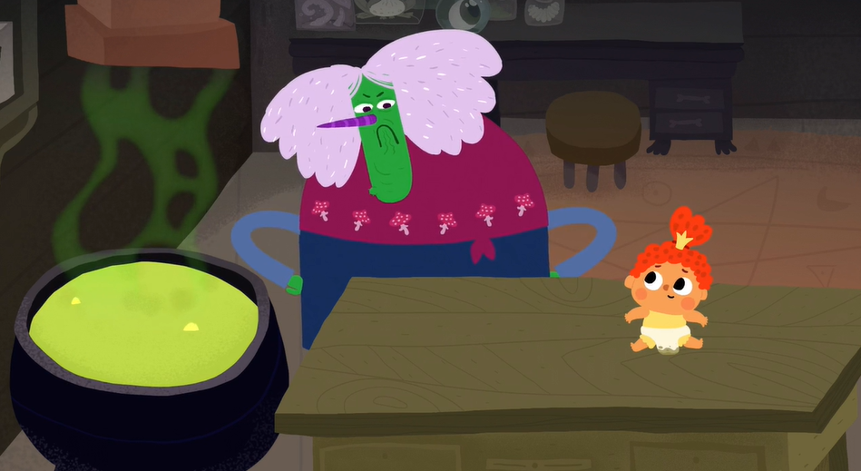
Early Years and Primary 1-4
Witch and the Baby, The — Evgenia Golubeva, 2020 | Screening Shorts
What do you need to do to take care of a baby?
The witch was bad because she was lonely. How does that feel? How could you help someone who is lonely?
What other fairy tales do you know? Is this film a fairy tale?
The nanny advert has a woman on it. Are there jobs that you think are more likely to be for women? Is this true?
The witch thinks she is ugly but is kind inside. What makes a person ugly on the inside?

Slide 11
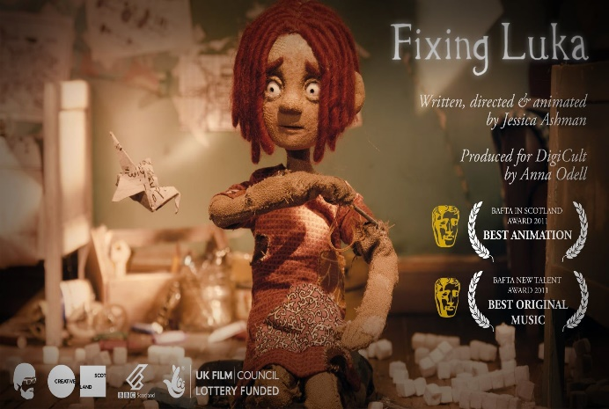
Primary 5 to Primary 7
Fixing Luka — Jessica Ashman, 2011 | Screening Shorts
What books, films, TV shows etc. can you think of that feature neurodiverse characters? How are they presented to the reader/viewer? Do you think this is accurate?
Greta Thunberg is autistic. Read here what she says about it. How has her autism been of benefit to her? Has any of this surprised you? Why (not)?
In the film, Lucy wants to fix her brother rather than support him as their mum does. How does their mum support Luka? How do/could you support a neurodiverse classmate?

Slide 12
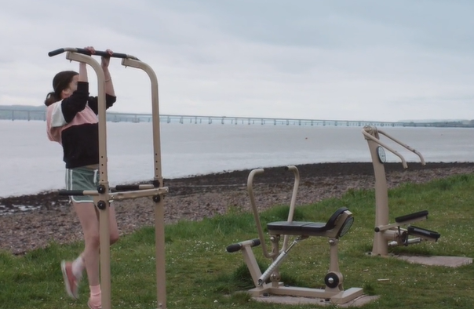
S1 to S3
Hello Muscles — Marnie Baxter, 2022 | Screening Shorts
Nearly one million young people in the UK have caring responsibilities. Did you know or suspect this? Many young carers are actually not identified – why might this be the case?
What do you think caring responsibilities might look like, both physical and emotional? What impact could these caring responsibilities have on a young person’s life?
What does the word ‘responsibility’ mean to you? What positive connotations does this word have? Negative?
Can you think of any other films, TV shows, books etc. that feature a young carer? If so, how are young carers represented? If not, why do you think this is the case?

Slide 13
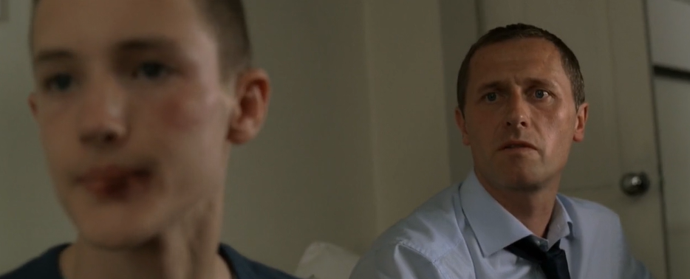
Senior Phase
Soft — Simon Ellis, 2006 | Screening Shorts
The dad says that the gang have a “short attention span”. Do you think he’s right or is this an ignorant assumption? What assumptions are being made about the gang members? Do you think these are fair?
What other films, TV shows, books etc. can you think of that explore similar ideas about masculinity to ‘Soft’? What are their similarities? How could these texts reinforce potentially harmful ideas about masculinity?
Do you think a male viewer would respond differently to this film than a female?

Slide 14

Potential Concerns
Discussing sensitive topics
Inviting openness from pupils
Offering a safe space
Willing to tackle polemical views
Child Protection responsibilities
Any others?
REMEMBER THE BENEFITS

Slide 15

Time to Chat
DISCUSS OUT LOUD OR VIA THE CHAT FUNCTION
What film and screen texts have produced surprising or interesting discussions in your classroom?
What do you think are the most important cultural discussions to have?

Slide 16

Any Questions?

Slide 17

Evaluation Time
The Screen Education Team want our Screen Sessions – and everything we do – to be led by those on the ground, so your feedback is really important to us.
Please take this time to think about what you’ve gained from today’s session and what questions you still have.
Pop your comments and questions in the meeting chat or feel free to send us your comments via: Gail.Robertson@creativescotland.com

Slide 18
Coming Up: Screen Sessions
Next month’s Screen Session (24 Jan) is:
3Cs OF SCREEN EDUCATION:
CREATIVE ACTIVITIES
You will find the booking link, alongside the full 2022/23 schedule and recordings of all our previous sessions here: Teacher CLPL Sessions | Screen Scotland

Slide 19
What next?
Visit our website Screening Shorts, with nearly 100 short films alongside teaching guides, activities and resources.
Join our network for updates on events/opportunities and to chat to other educators: Screen Scotland: Screen Education | Microsoft Teams
Consider applying to our Screen Education Fund: you can ask for up to £35,000 to pilot a screen education project.
Learn more about Screen Scotland’s Education work: Screen Education | Screen Scotland Website
Contact the Screen Education Team directly:
  Fi.Milligan-Rennie@creativescotland.com Head of Education - Screen
  Gail.Robertson@creativescotland.com Screen Education Officer

