Slide 1


SHORT CUTS
THE BENEFITS OF TEACHING WITH SHORT FILM
15 March 2022

Slide 2

Today’s Schedule
4.30pm Scott Donaldson: Welcome and Introduction
4.35pm Ainslie Henderson
4.50pm Michaël Dudok de Wit
5.05pm Question and Answer Session
5.25pm Feedback
5.30pm End

Slide 3
Our Aim
To inspire and equip people across Scotland to be able to
enjoy,
understand,
create,
explore and
share
film in all its forms throughout their lives.

Slide 4
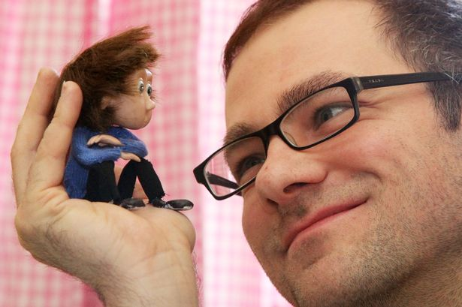
Ainslie Henderson
Ainslie Henderson is a Writer/Director/Animator/ who, in 2012 was awarded a BAFTA for co-writing ‘The Making of Longbird.’
Ainslie’s following short films ‘I Am Tom Moody’ and ‘Monkey Love Experiments’ were both BAFTA nominated, and have won over 60 international festival awards, including; Best British short at Encounters, and the Jury crystal at Annecy.
‘Moving On’- his music video for the band ‘James’ - has clocked up over 1.9m plays on Vimeo, and was awarded the UK’s Best animated music video. His latest short film ‘Stems’ was awarded Edinburgh International film festival’s McLaren award.
In 2016, he and creative partner, Will Anderson produced the animated content for Martin Green’s show ‘Flit’, which toured internationally and was awarded 4 stars in the Guardian newspaper.
Ainslie has a particular love of stop frame animation and is currently freelancing between Edinburgh and Newcastle.

Slide 5
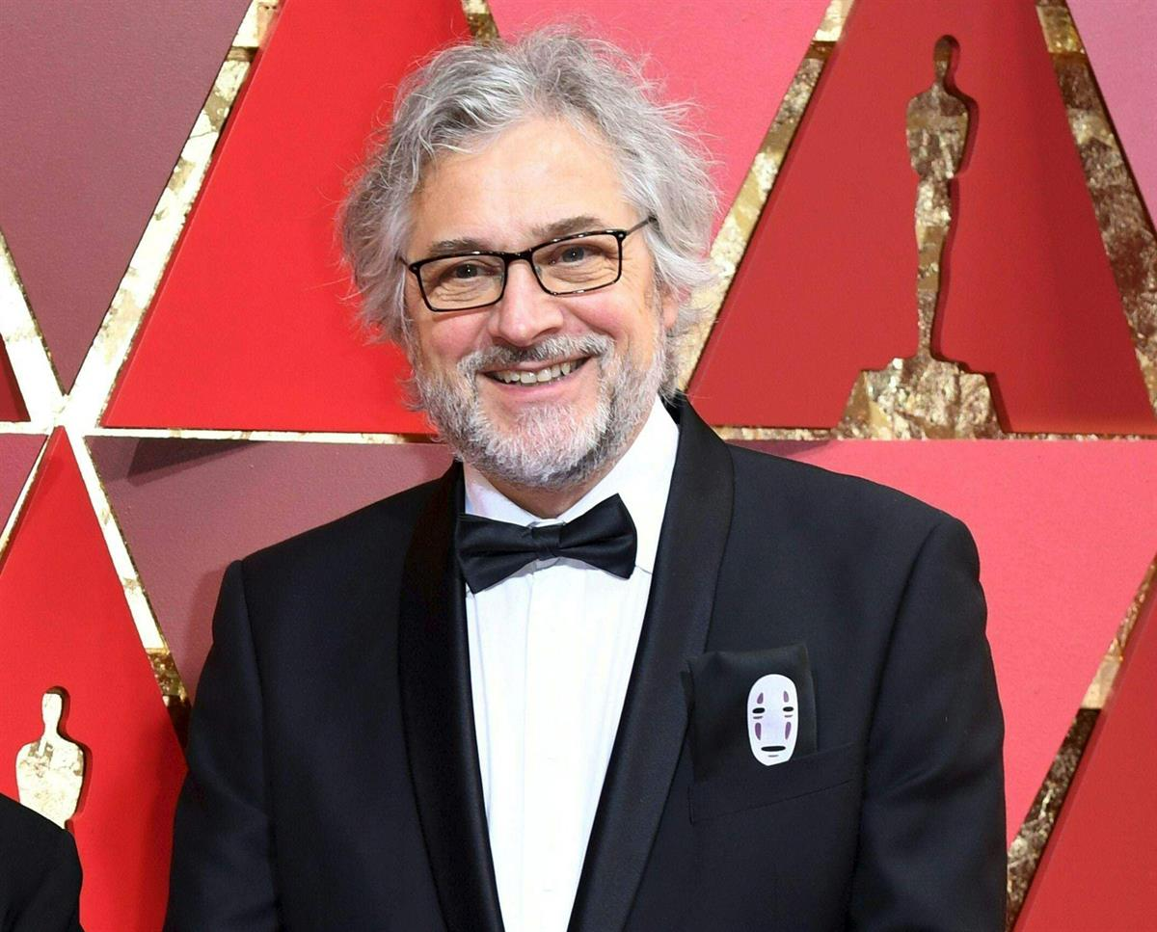
Michaël Dudok de Wit
Michaël Dudok de Wit is a Dutch animator, director and illustrator based in London.
In 1992, he created the short film ‘Tom Sweep’, followed by ‘The Monk and the Fish’ (1994) which was made in France with the studio Folimage. This film was nominated for an Oscar and has won numerous prizes including a César Award for Best Short Film and the Cartoon d’or. Michael also writes and illustrates children's picture books and teaches animation at art colleges in England and abroad.
His film ‘Father and Daughter’ (2000) won an Academy Award, a BAFTA Award, the Grand Prix at Annecy and dozens of other major awards. In 2006, he made the short film ‘The Aroma of Tea’, which was drawn entirely with tea.
In 2016, he released the feature-length film ‘The Red Turtle’ which was nominated for Best Animated Feature Film at the 9th Academy Awards.

Slide 6
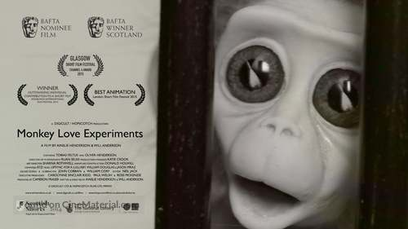

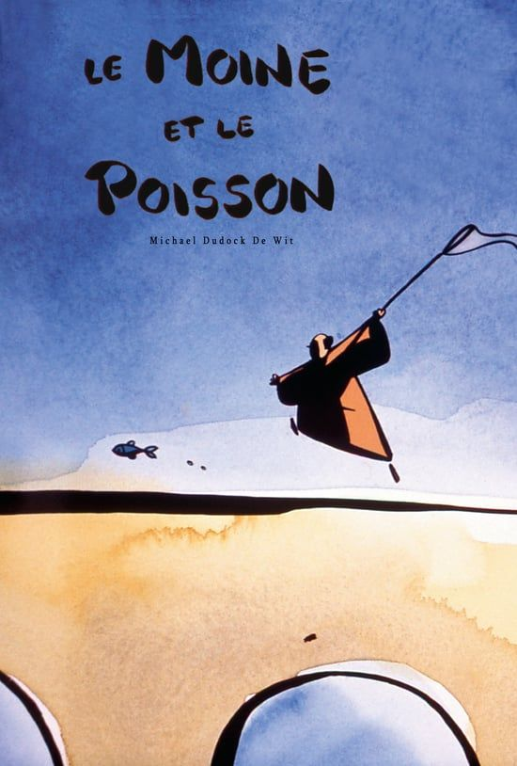
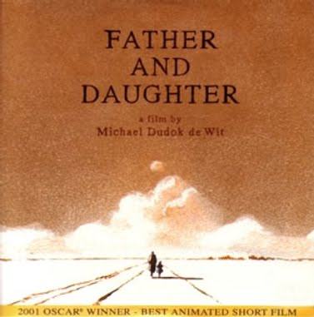
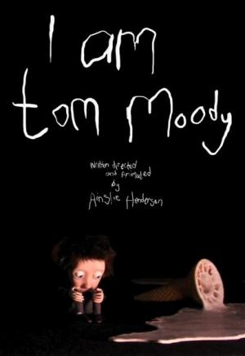
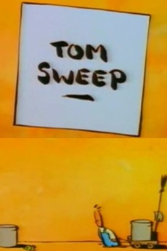
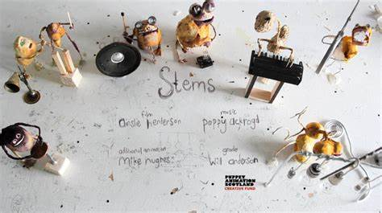

Slide 7
Links from today’s session
Ainslie Henderson
I Am Tom Moody — Ainslie Henderson, 2012 | Screening Shorts
Monkey Love Experiments — Ainslie Henderson and Will Anderson, 2015 | Screening Shorts
Stems — Ainslie Henderson, 2016 | Screening Shorts
Ainslie Henderson - Writer | Director | Animator
Michaël Dudok de Wit
Father and Daughter — Michaël Dudok de Wit, 2000 | Screening Shorts
Monk and the Fish, The — Michaël Dudok de Wit, 1994 | Screening Shorts
Tom Sweep — Michaël Dudok de Wit, 1992 | Screening Shorts
The Red Turtle Official International Trailer 1 (2016) - Animated Movie - YouTube

Slide 8

Glasgow Short Film Festival
Scotland's leading short film event | Glasgow Short Film Festival

Slide 9
Want to learn more?
Find short films, teaching resources, video tutorials and classroom activities:
Screening Shorts
Keep up-to-date with film education events/opportunities and chat to other educators:
Screen Scotland: Film Education | Microsoft Teams
Learn more about our work and the role of film education:
Film Education | Screen Scotland Website
Contact us directly:
Fi.Milligan-Rennie@creativescotland.com Head of Education - Screen
Gail.Robertson@creativescotland.com Screen Education Officer
Follow us on Twitter:
@FilmEdScSc

Slide 10

Feedback Time
Please leave us some feedback on our Padlet: Short Cuts: The Benefits of Short Film (padlet.com). The link has been posted in the chat too.​

