Slide 1


STEP UP:
UNIVERSITY AND COLLEGE COURSES IN FILM
19 October 2021

Slide 2

Today’s Schedule
4.30pm Scott Donaldson: Welcome and Introduction
4.35pm Kirsten MacLeod: Edinburgh Napier University
4.45pm Dario Sinforiani: University of Stirling
4.55pm Jared Taylor: Edinburgh College of Art
5.05pm Sam Firth: University of the West of Scotland
5.15pm Questions and Feedback
5.30pm End

Slide 3
Our Aim
To inspire and equip people across Scotland to be able to
enjoy,
understand,
create,
explore and
share
film in all its forms throughout their lives.

Slide 4

Kirsten MacLeod
Dr. Kirsten MacLeod is Associate Professor in Creative Media Practice and Programme Leader for BA Television at Edinburgh Napier University.

Slide 5
Scripted/Drama Production Courses
Scotland 2021/22
Dr. Kirsten MacLeod
Associate Professor Creative Media Practice
Edinburgh Napier University (k.macleod2@napier.ac.uk)

Slide 6
Drama/ Scripted Production Programmes
BA (Hons) Film Edinburgh Napier
https://www.napier.ac.uk/courses/ba-hons-film-undergraduate-fulltime
BA (Hons) Television, Edinburgh Napier. Direct entry 3rd yr (following college HNC, HND)
https://www.napier.ac.uk/courses/ba-hons-television-undergraduate-fulltime
Royal Conservatoire Scotland, Glasgow
BA Filmmaking: https://www.rcs.ac.uk/film/ https://www.rcs.ac.uk/courses/ba-filmmaking/
University of the West of Scotland
BA (Hons) Broadcast Production: Television & Radio https://www.uws.ac.uk/study/undergraduate/undergraduate-course-search/broadcast-production-tv-radio/

Slide 7
For more Information
Screenskills: https://www.screenskills.com/starting-your-career/job-profiles/film-and-tv-drama/
Royal Television Society: https://rts.org.uk/education-and-training-pages/education-training
Creative Scotland: https://www.creativescotland.com/resources
Screen Scotland: https://www.screen.scot/film-education
BAFTA Guru: http://guru.bafta.org/

Slide 8
Financiers Financial Guarantors
Executive Producer(s)
Producer(s)
Director
Writer(s)
Line Producer/co-producer
Composer
Editor
Construction
Manager
Sound Recordist
Lighting Gaffer
Director of
Photography
Production
Designer
Production
Manager
Ist Asst
Director
Make-up
Designer
Costume
Designer
Production Accountant
Assistant
Editor
Chippie(s)
Boom Operator
Best Boy
Camera Operator
Art Director
Production Coordinator
2nd Asst Director
Make-up Artist
Costume Supervisor
Accounts Assistant
Dubbing
Editor
Painter(s)
Sound Trainee(s)
Electricians
Focus Puller(1st AC)
Graphic Artists
Production Secretary
3rd Asst Director
Dailies
Wardrobe Asst(s)
Cashier
Post-production
Supervisor
Digitial Imaging Technician
Stage Hand(s)
Art Dept Assistant(s)
Production Runner(s)
Floor Runner(s)
Trainee(s)
Dailies
Grip
Clapper Loader
(2nd AC)
Foley Artist
Rigger(s)
Props Master
Props Buyer
Production Trainee(s)
Trainee(s)
Video Assist
Continuity Supervisor
Editing Trainee
Standby Props
Location Manager
Continuity Trainee
Camera Trainee(s)
Dressing Props
Casting Director
Post Production FX CGI
Unit Manager
Location Assistant(s)
Location Caterers
Publicity Stills
BASIC UK drama unit

Slide 9
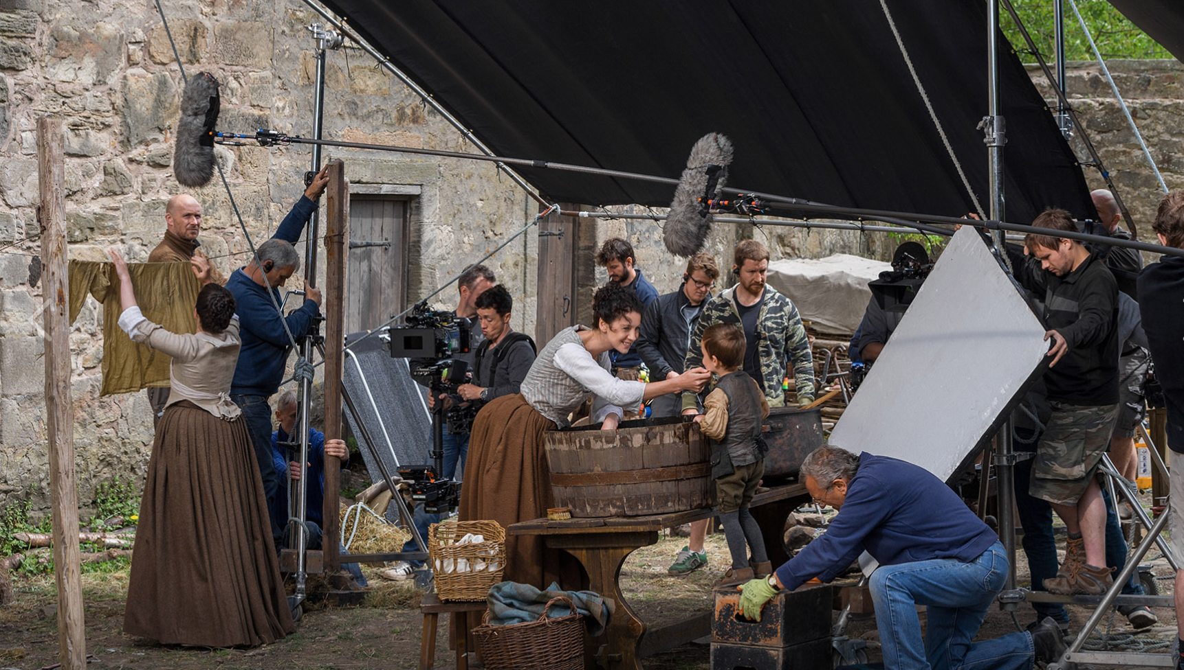
Production is Booming in Scotland!

Slide 10
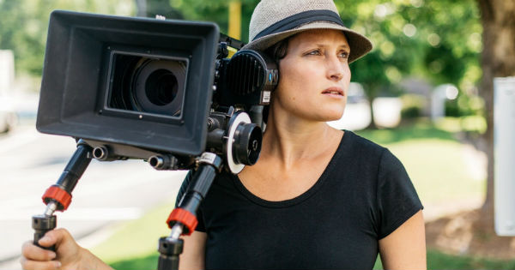
Any Questions?

Slide 11

Dario Sinforiani
Dario Sinforiani coordinates the video production modules and teaches on degrees in Film & Media and Journalism at the University of Stirling. He has taught practical television and film making since 2004 and has combined teaching with an active career in production.

Slide 12

Jared Taylor
Jared Taylor FHEA MA(RCA) is the programme director for undergraduate Animation at Edinburgh College of Art within the University of Edinburgh.
He has worked in the video games industry for 13 years prior to working as an Animation educator in art schools in London and Edinburgh for the last 15 years. Currently he is the external assessor for Animation programmes at the Royal College of Art and the University of the Arts in London.
He has taught over 800 animators and worked for clients such as Konami, Nintendo, Lego, Square Enix etc. as well as directing the world’s largest 360’ rotoscope shoot.

Slide 13


Survey of Scottish HE Animation Programmes
Jared Taylor FHEA MA(RCA)
Programme Director (Animation)
Edinburgh College of Art
              Where to study what?
              The DREADED portfolio…
www.ed.ac.uk www.eca.ed.ac.uk

Slide 14
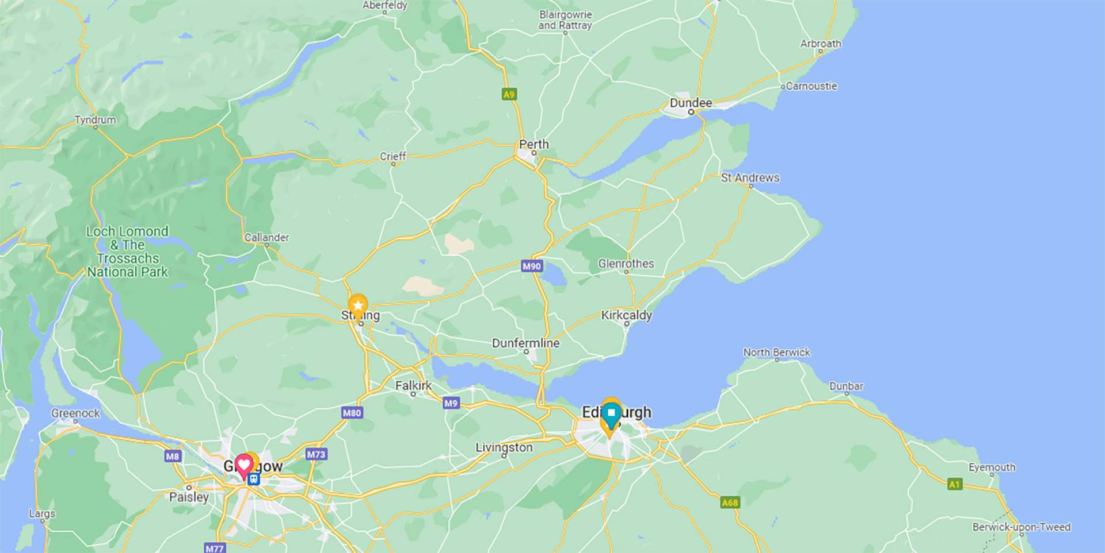

Slide 15






7 Universities / Colleges
9 Programmes / Courses

Slide 16
Animation
Institutions | Programme Title | Duration | Entry Requirements | Notes
Duncan of Jordanstone College of Art University of Dundee | Animation BDes (Hons) | 1 year Foundation Course 3 years full time | ABBB Higher | at Advanced Higher, including Art and Design or a related subject and an appropriate literate subject, plus BB at Higher in different subjects including one other subject outside Art and Design.
Edinburgh College of Art University of Edinburgh | Animation BA (Hons) | 4 years full time | ABBB Higher | ABBB by end of S5 or AABB/ABBBB by end of S6. BBB must be achieved in one year of S4-S6. Required subjects: Highers: no specific Higher subjects required. National 5s: English at C.
www.ed.ac.uk www.eca.ed.ac.uk

Slide 17
Visual Effects / Animation
Institutions | Programme Title | Duration | Entry Requirements | Notes
Glasgow Caledonian University | 3D Animation and Visualisation BSc (Hons) | 4 years full time | BBBB Higher | to include Art & Design or Graphic Communication
SAE (School of Audio Engineering) | Visual Effects Animation BA (Hons)/BSc (Hons) | 2 years full time | CCCD Higher | Must include English
www.ed.ac.uk www.eca.ed.ac.uk

Slide 18
Games / Computer Animation
Institutions | Programme Title | Duration | Entry Requirements | Notes
Abertay University | Computer Arts BA (Hons) | 4 years full time | AABB Higher | To include Art or Photography or Graphic Communication or Production Design
Glasgow Caledonian University | 3D Animation and Visualisation BSc (Hons) | 4 years full time | BBBB Higher | to include Art & Design or Graphic Communication
Glasgow School of Art | Games and Virtual Reality BSc (Hons) | 4 years full time | ABBB Higher | Scottish Highers: ABBB and above (one sitting) or AABB and above (two sittings) to include Maths
SAE (School od Audio Engineering) | Game Art Animation BA (Hons)/BSc (Hons) | 2 years full time | CCCD Higher | Must include English
University of the West of Scotland | Computer Animation Arts BSc (Hons) | 4 years full time | ABBB Higher | Including Art & Design; Photography or Graphic Communication.
www.ed.ac.uk www.eca.ed.ac.uk

Slide 19
Animation, sort of…
Institutions | Programme Title | Duration | Entry Requirements | Notes
Glasgow School of Art | Communication Design BA (Hons) | 4 years full time | ABBB Higher | Scottish Highers: ABBB and above (one sitting) or AABB and above (two sittings) to include Maths
www.ed.ac.uk www.eca.ed.ac.uk

Slide 20
The DREADED Portfolio
Essential Portfolio Assets
Demonstration of life drawing ability
Confident use of a variety of drawing media and techniques
Confident use of colour
Evidence of sequencing or pattern in folio (Drawings/prints of objects
changing state, or drawings/prints of repeating pattern. for example.)
Evidence of narrative or storytelling (Written evidence or storyboarding
or comic strips for example.)
Confident use of IT
www.ed.ac.uk www.eca.ed.ac.uk

Slide 21
The DREADED Portfolio
Desirable Portfolio Assets
Familiarity with a 3D modelling & animation package (Such as Maya or 3D Studio Max for example.)
Familiarity with 2D painting or photo manipulation packages
(Photoshop or Painter for example.)
Familiarity with compositing software (Premiere or After Effects for
example.)
Any form of animation
www.ed.ac.uk www.eca.ed.ac.uk

Slide 22
The DREADED Portfolio
Things To Consider When Discussing Animation With Potential Tutors
Candidates should be able to express an awareness of the medium in its different forms
Candidates should be able to confidently express their reasons for wanting to be an animator
Candidates should be able to clearly express their career ambitions
Candidates should be able to identify a role model from within the medium of animation
www.ed.ac.uk www.eca.ed.ac.uk

Slide 23
THINGS TO AVOID IN A PORTFOLIO FOR APPLICATION TO ART SCHOOL
Skulls, Ninjas, Robots, Fan art, Suicide, Dragons, Cyborgs, Zombies, Copying, Dream catchers, Drawing from photographs, Inspirational work from Deviant Art, Drawings or photos of the pony you wish you had. If you have to do an expressive self portrait, then don’t make it about rage, anger, terror, fury, boredom or ennui…, Photos of your pets, The Grim Reaper, Giant Eyeballs, Spaceships, Vampires, Swords, Guns, Cars, People with kitten ears, Plague masks…
www.ed.ac.uk www.eca.ed.ac.uk

Slide 24
Unless, UNLESS, they are mind-blowingly good examples…
www.ed.ac.uk www.eca.ed.ac.uk

Slide 25

Sam Firth
Sam Firth is a practicing filmmaker and lecturer with an interest in both documentary and fiction filmmaking. She has worked in the film industry for over twenty years in a number of different roles and made short films during this time. She is the programme leader for the BA Filmmaking and recently had the premiere of her first feature film The Wolf Suit at the BFI London Film Festival.

Slide 26

BA (Hons) Filmmaking and Screen Writing at
Creative Filmmaking
Screenwriting
Film Studies

Slide 27
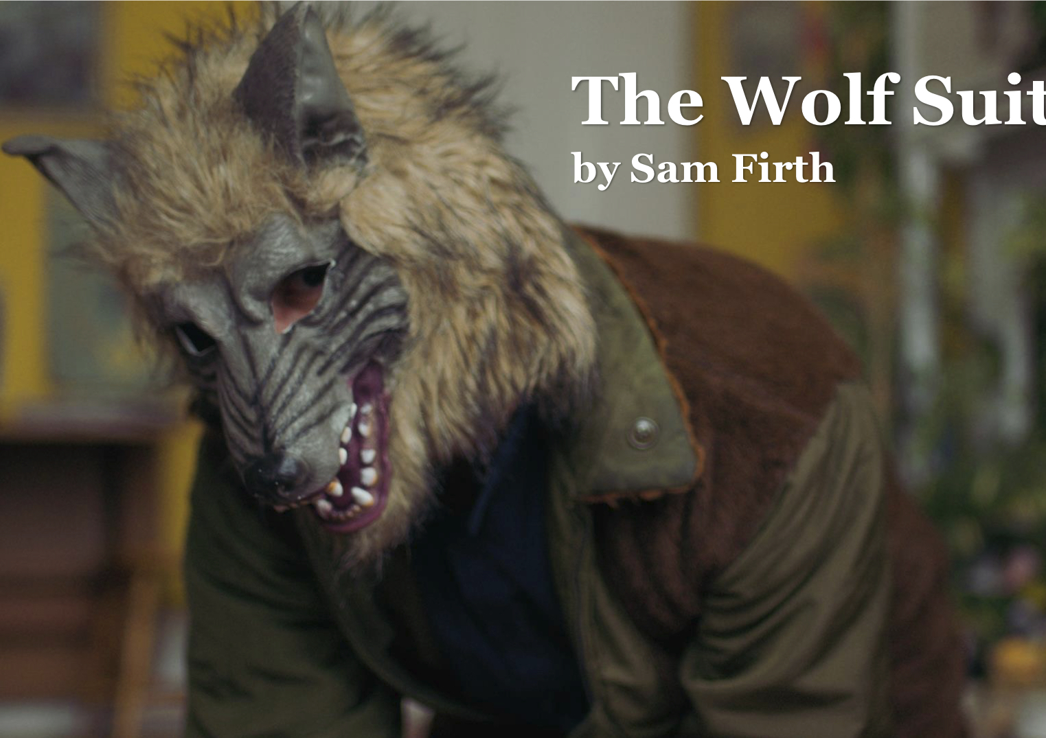
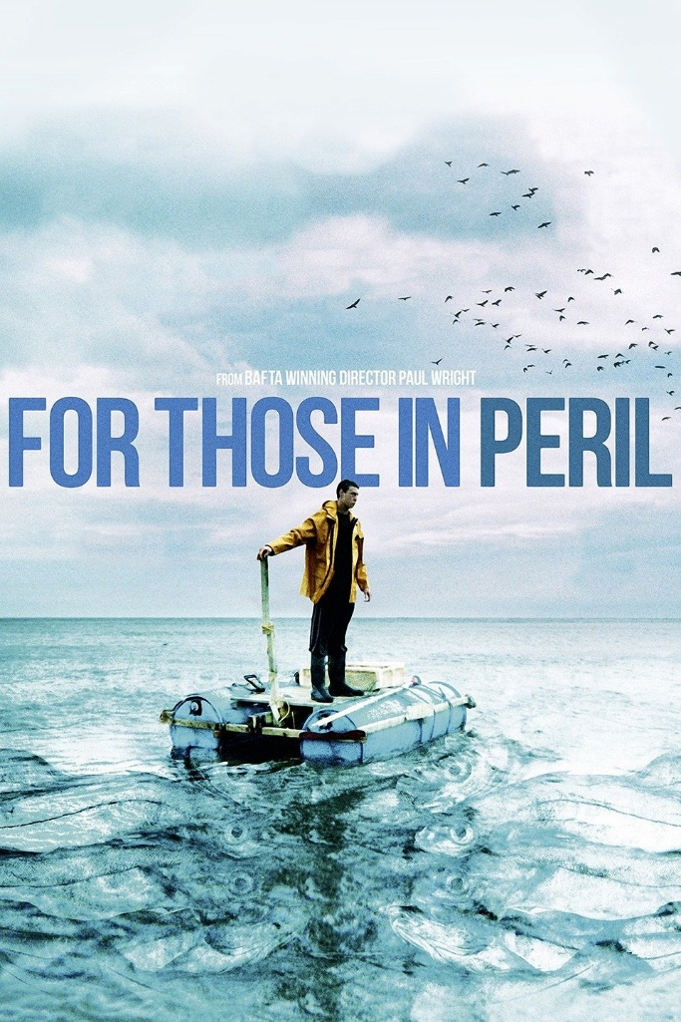

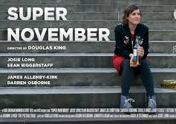
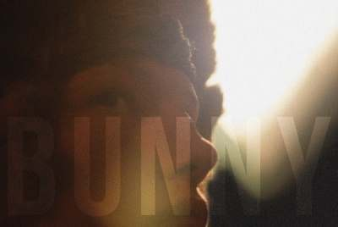
Filmmaking Tutors: Sam Firth, Shaun Hughes
Douglas King, Paul Wright

Slide 28
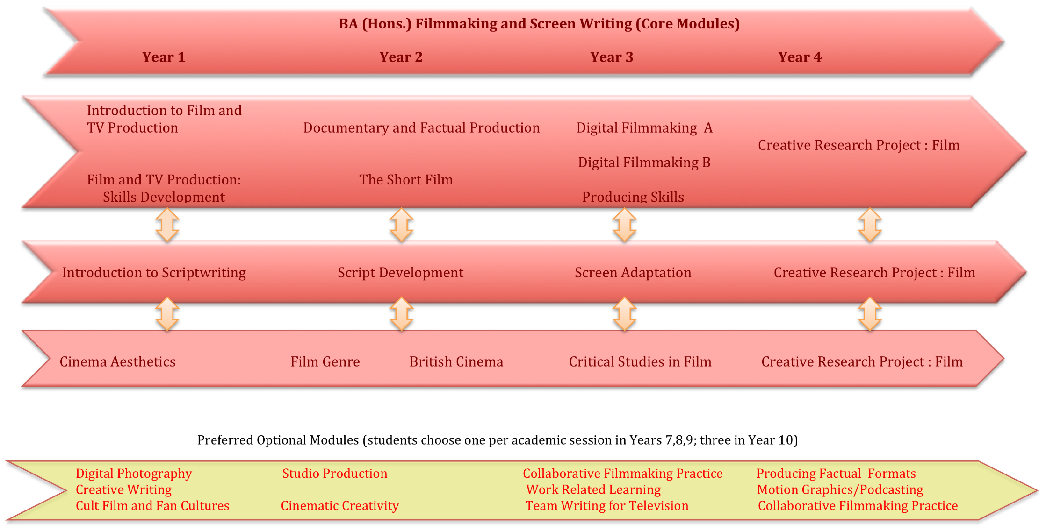
Notes:
The short film

Slide 29
BA Filmmaking at
Key Facts
Screen skills accreditation - the course meets professional standards
Based at Ayr, with some lessons at Film City, Glasgow
Sept-Jan; Jan - May. No exams, all coursework.
No extra costs, all equipment is provided
Entry at Level 8 or 9 with a recognised HND in filmmaking

Slide 30
Scottish University Film and TV Courses
University of the West of Scotland | Filmmaking & Screenwriting Broadcast Production (TV & Radio) Computer Animation Arts New Media Art | Edinburgh Napier University | Film English & Film Acting & Film Stage & Screen Acting Television
University of Edinburgh | Film & Television Animation Performance Costume | Queen Margaret University, Edinburgh | Film & Media Theatre & Film Costume Design & Construction
University of Dundee | English & Film Studies Philosophy & Film Animation | University of the Highlands & Islands | Contemporary Filmmaking in the Highlands & Islands Interactive Media
SAE Institute, Glasgow (a private institution) | Digital Film Production Game Art Animation Visual Effects Animation | Royal Conservatoire of Scotland, Glasgow | Filmmaking Production Arts & Design
Glasgow Caledonian University | 3D Animation & Visualisation | University of Glasgow | Film & Television Studies
University of St Andrews | Film Studies | University of Stirling | Film & Media
Sabhal Mor Ostaig (UHI) | Gaelic Media | Abertay University, Dundee | Computer Arts
University of Aberdeen | Film & Visual Culture

Slide 31
Want to learn more?
Find short films, teaching resources, video tutorials and classroom activities here:
Screening Shorts
Keep up-to-date with film education events and opportunities and chat to other educators interested in film here:
Screen Scotland: Film Education | Microsoft Teams
Learn more about our work and the role of film education here:
Film Education | Screen Scotland Website
Or contact us directly via:
Scott.Donaldson@creativescotland.com Head of Film Education
Gail.Robertson@creativescotland.com Film Education Officer

Slide 32
Links from today’s session
Edinburgh Napier University
On-campus Open Day: Sat 30 October 2021
University of Stirling
Virtual Open Day: Sat 23 October 2021
Edinburgh College of Art
Open Days: TBC 2022
University of the West of Scotland
Online Open Day: Sat 23 October 2021

Slide 33

Question Time
Please leave us some feedback on our Padlet: Step Up: University and College Courses in Film (padlet.com) The link has been posted in the chat too.​

