Slide 1


THE PRODUCERS:
BASIC FILMMAKING ACROSS THE CURRICULUM AND FILM COMPETITIONS
21 September 2021

Slide 2

Today’s Schedule
4.30pm Welcome and Introduction: Scott Donaldson and Gail Robertson
4.40pm Making an Animation Film: Jonathan Charles
4.50pm Making a Documentary Film: Yasmin Al-Hadithi
5.00pm Making a Fiction Film: Alasdair Satchel
5.10pm Film Competitions: Scott Donaldson and Gail Robertson
5.15pm Questions and Feedback
5.30pm End

Slide 3
Our Aim
To inspire and equip people across Scotland to be able to
enjoy,
understand,
create,
explore and
share
film in all its forms throughout their lives.

Slide 4

Jonathan Charles
Jonathan Charles of D Fie Foe will demonstrate a basic classroom animation set-up, and introduce the fundamentals of animation.

Slide 5

Yasmin Al-Hadithi
Yasmin Al-Hadithi is a Glasgow-based artist, filmmaker and film education practitioner.
She is co-founder of DOCMAdocs, a global platform for the playful exploration of different documentary filmmaking styles.
Yasmin will be introducing you to some simple approaches you can use to explore topics with your class through the use of fun, creative documentary films.

Slide 6

Alasdair Satchel
Alasdair Satchel is a film and theatre maker based on the Isle of Mull. His session will be looking at shot types and how we can create visual stories from very simple means.

Slide 7
Film Competitions
CURRENTLY RUNNING
Climate Challenge: 1.5 Degrees Films:
  Climate Challenge: 1.5 Degrees Films – Film Access Scotland
Our World:
  About Our World — SEET
FUTURE COMPETITIONS
Edinburgh and Lothians Schools Film Competition 2022:
  Edinburgh and Lothians Schools Film Competition 2021 Winners Announced | Screen Education Edinburgh (screen-ed.org)
Scottish Youth Film Festival 2022
  Festival | Scottish Youth Film Foundation (syff.scot)

Slide 8
Want to learn more?
Find short films, teaching resources, video tutorials and classroom activities here:
Screening Shorts
Keep up-to-date with film education events and opportunities and chat to other educators interested in film here:
Screen Scotland: Film Education | Microsoft Teams
Learn more about our work and the role of film education here:
Film Education | Screen Scotland Website
Or contact us directly via:
Scott.Donaldson@creativescotland.com Head of Film Education
Gail.Robertson@creativescotland.com Film Education Officer

Slide 9
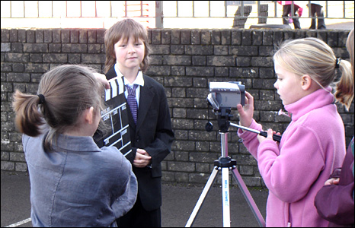
Making Films
Time: An hour to film. A day to edit. A minute to watch.
Equipment: Keep it simple.
Help: Don’t be afraid of looking for help – ask the pupils!
Practice: Make your own film!
Planning: Saves time and builds confidence.
Shooting: Trust is key.
Editing: A vital stage – and so satisfying!
Viewing: Find a big audience!

Slide 10
Links from today’s session
Animation
Stop Motion Studio: https://www.cateater.com/
Documentary
Creative Documentary Techniques: https://vimeo.com/604840485
  Password: one-minute
Fiction Film
Shot Types Session: Shot Types Session (padlet.com)

Slide 11

Question Time
Please leave us some feedback on our Padlet: The Producers: Basic Filmmaking Across the Curriculum and Film Competitions (padlet.com)The link has been posted in the chat too.​

